Slide 1
OPENING / DEVFEST KC
DEVFEST KC / 2026
Predictive Modeling
of Cloud System Failures
Map. Simulate. Score.
Dependency graphs + counterfactual risk estimation
Akhil Joshi
01
Symptoms
02
Problem
03
Map, Simulate, Score
04
Limitations
05
Real-world Comparison
06
Takeaways

Slide 2
OPENING / MEET AKHIL
DEVFEST KC / 2026
Akhil Joshi
Cloud Platform Engineer at Koch Industries
Big Four alumnus: Deloitte + PwC
M.S. in Computer Science / Kansas State University
8+ peer-reviewed research papers
AWS + Azure certified
Cloud-native / CNCF community participant
OFF THE CLOCK
Marvel comics / Chess / Badminton

Slide 3
ACT 1 OF 6 / SYMPTOMS
DEVFEST KC / 2026
One incident. Three perspectives.
The customer
A purchase or update does not complete.
The engineer
Several true alerts; limited context.
The system
Shared dependencies and delayed consequences.
01
Symptoms
02
Problem
03
Map, Simulate, Score
04
Limitations
05
Real-world Comparison
06
Takeaways

Slide 4
ACT 1 OF 6 / SYMPTOMS
DEVFEST KC / 2026
AWS: the DNS fix was not the end.
00:00 / onset
DynamoDB endpoint resolution fails.
+00:50 / diagnosis
DNS state identified as the source.
+02:52 / DDB API recovery
Dependent systems still need recovery.
+14:32 / summary window ends
EC2 / networking recovery followed different paths.
01
Symptoms
02
Problem
03
Map, Simulate, Score
04
Limitations
05
Real-world Comparison
06
Takeaways

Slide 5
ACT 1 OF 6 / SYMPTOMS
DEVFEST KC / 2026
Cloudflare: one bad file, hours of recovery.
11:20 / reported onset
Proxy failures and widespread HTTP errors.
Initial investigation
DDoS suspected; actual cause was configuration data.
14:30 / core traffic restored
About 3h 10m from the opening timestamp.
17:06: all systems restored / 5h 46m overall.
01
Symptoms
02
Problem
03
Map, Simulate, Score
04
Limitations
05
Real-world Comparison
06
Takeaways

Slide 6
ACT 1 OF 6 / SYMPTOMS
DEVFEST KC / 2026
Shrink the same problem into one checkout journey.
Login
Auth
Gateway
Checkout
Payment
Database
Orders
Kafka
Worker
Dependency arrows: consumer -> provider. Worker consumes from Kafka.
01
Symptoms
02
Problem
03
Map, Simulate, Score
04
Limitations
05
Real-world Comparison
06
Takeaways

Slide 7
ACT 1 OF 6 / SYMPTOMS
DEVFEST KC / 2026
02:14 AM. The on-call alerts start arriving.
02:14 Gateway / 5xx errors
02:15 Login / slow responses
02:15 Checkout / p95 latency
02:16 Payment / timeouts
02:17 Checkout / retries rising
02:19 Journey / success rate falling
01
Symptoms
02
Problem
03
Map, Simulate, Score
04
Limitations
05
Real-world Comparison
06
Takeaways

Slide 8
ACT 1 OF 6 / SYMPTOMS
DEVFEST KC / 2026
A shared dependency is a lead, not a verdict.
Login
Auth
Gateway
Checkout
Payment
Database
Orders
Kafka
Worker
Auth could explain more symptoms. Verify it with traces and timing.
01
Symptoms
02
Problem
03
Map, Simulate, Score
04
Limitations
05
Real-world Comparison
06
Takeaways

Slide 9
ACT 2 OF 6 / PROBLEM
DEVFEST KC / 2026
The problem is a missing system-level view.
Which component failures could create widespread impact?
Inputs: components + relationships + operating signals.
01
Symptoms
02
Problem
03
Map, Simulate, Score
04
Limitations
05
Real-world Comparison
06
Takeaways

Slide 10
ACT 2 OF 6 / PROBLEM
DEVFEST KC / 2026
What would a useful answer give us?
Impact
Which customer journey could this failure affect?
Priority
Which scenarios deserve our attention first?
Evidence
What should we check, and why?
A better engineering decision, not an exact outage date.
01
Symptoms
02
Problem
03
Map, Simulate, Score
04
Limitations
05
Real-world Comparison
06
Takeaways

Slide 11
ACT 3 OF 6 / MAP, SIMULATE, SCORE
DEVFEST KC / 2026
Start with an inventory, not a perfect diagram.
COMPONENT RECORD
Component: Payment service
Depends on: Auth + payment database
Relationship: Required API call / database connection
Context: Owner + environment + evidence + last verified
List the components first. Add the relationships to create a graph.
01
Symptoms
02
Problem
03
Map, Simulate, Score
04
Limitations
05
Real-world Comparison
06
Takeaways

Slide 12
ACT 3 OF 6 / MAP, SIMULATE, SCORE
DEVFEST KC / 2026
Generate relationships from evidence.
COLLECT
NORMALIZE
CONNECT
REVIEW
Inventory, configuration and traces.
Match component identities.
Typed, directed relationships.
Verify critical edges and gaps.
Keep provenance and freshness. Do not erase a known edge because its error correlation is low.
01
Symptoms
02
Problem
03
Map, Simulate, Score
04
Limitations
05
Real-world Comparison
06
Takeaways

Slide 13
ACT 3 OF 6 / MAP, SIMULATE, SCORE
DEVFEST KC / 2026
Topology gives paths. Telemetry adds context.
PATH
STATE
BEHAVIOUR
Who depends on whom?
What is changing now?
What happens next?
Configuration + traces
Latency + retries + saturation
Timeouts + fallbacks + queue lag
Signals inform scenario rules; correlation alone does not prove a dependency.
01
Symptoms
02
Problem
03
Map, Simulate, Score
04
Limitations
05
Real-world Comparison
06
Takeaways

Slide 14
ACT 3 OF 6 / MAP, SIMULATE, SCORE
DEVFEST KC / 2026
What is manual, automated or AI-assisted?
Software
Collect, reconcile, traverse, repeat and calculate.
Engineers
Define scope, failure behavior and impact limits.
AI / optional
Suggest candidates, retrieve evidence and explain.
01
Symptoms
02
Problem
03
Map, Simulate, Score
04
Limitations
05
Real-world Comparison
06
Takeaways

Slide 15
ACT 3 OF 6 / MAP, SIMULATE, SCORE
DEVFEST KC / 2026
Simulate in the model, not in production.
01 / Select + inject
Choose one component and a defined failure mode.
02 / Follow + apply
Traverse dependents using explicit impact rules.
03 / Measure + reset
Record impact; restore the model for the next run.
04 / Repeat
Try every component under varied conditions.
01
Symptoms
02
Problem
03
Map, Simulate, Score
04
Limitations
05
Real-world Comparison
06
Takeaways

Slide 16
ACT 3 OF 6 / MAP, SIMULATE, SCORE
DEVFEST KC / 2026
What if Auth fails?
Login
Auth
MODELED SCENARIO
AUTH OUTAGE
Red = injected failure
Gateway
Amber = potential impact
Checkout
Payment
Database
Orders
Kafka
Worker
Potential: Login, Checkout, Payment and Gateway. Async infrastructure is outside this failure path.
01
Symptoms
02
Problem
03
Map, Simulate, Score
04
Limitations
05
Real-world Comparison
06
Takeaways

Slide 17
ACT 3 OF 6 / MAP, SIMULATE, SCORE
DEVFEST KC / 2026
What if Database fails?
Login
Auth
MODELED SCENARIO
DATABASE OUTAGE
Red = injected failure
Gateway
Amber = potential impact
Checkout
Payment
Database
Orders
Kafka
Worker
Potential: Payment, Checkout and Gateway. Login is outside this database failure path.
01
Symptoms
02
Problem
03
Map, Simulate, Score
04
Limitations
05
Real-world Comparison
06
Takeaways

Slide 18
ACT 3 OF 6 / MAP, SIMULATE, SCORE
DEVFEST KC / 2026
What if Kafka fails?
Login
Auth
MODELED SCENARIO
KAFKA OUTAGE
Red = injected failure
Gateway
Amber = potential impact
Checkout
Payment
Database
Orders
Kafka
Worker
Potential: Orders and Worker progress. Checkout impact depends on publication policy.
01
Symptoms
02
Problem
03
Map, Simulate, Score
04
Limitations
05
Real-world Comparison
06
Takeaways

Slide 19
ACT 3 OF 6 / MAP, SIMULATE, SCORE
DEVFEST KC / 2026
One equation. No memorisation required.
Risk = P(impact >= limit | selected failure)
How often does simulated impact cross our chosen line?
Research framing: DG-CFRM / Akhil Joshi + Akshitha Segireddy
Use the framing. Define an impact measure that matches your own system.
01
Symptoms
02
Problem
03
Map, Simulate, Score
04
Limitations
05
Real-world Comparison
06
Takeaways

Slide 20
ACT 3 OF 6 / MAP, SIMULATE, SCORE
DEVFEST KC / 2026
Define impact before calculating risk.
Teaching impact = degraded components / 9
Chosen line: 30% -> 3 or more components
Your team can choose customer impact, freshness or weighted journeys instead.
01
Symptoms
02
Problem
03
Map, Simulate, Score
04
Limitations
05
Real-world Comparison
06
Takeaways

Slide 21
ACT 3 OF 6 / MAP, SIMULATE, SCORE
DEVFEST KC / 2026
The simulator does the counting.
Estimated risk = runs crossing the limit / total runs
981 / 1000 = 0.981
Auth result from the included teaching simulation. Not a production probability.
01
Symptoms
02
Problem
03
Map, Simulate, Score
04
Limitations
05
Real-world Comparison
06
Takeaways

Slide 22
ACT 3 OF 6 / MAP, SIMULATE, SCORE
DEVFEST KC / 2026
Rank the modeled impact. Keep criticality separate.
Auth
0.981
Payment
0.855
Database
0.854
Kafka
0.760
Conditional impact only. A low cascade score is not low business criticality.
01
Symptoms
02
Problem
03
Map, Simulate, Score
04
Limitations
05
Real-world Comparison
06
Takeaways

Slide 23
ACT 4 OF 6 / LIMITATIONS
DEVFEST KC / 2026
What our model cannot do.
Four limits worth saying out loud
Predict the exact time
Prove the root cause
It cannot tell us when a component will fail.
The exact migration, bug or config change needs evidence.
Fill in missing dependencies
Guarantee accuracy
Bad edges or stale telemetry can mislead the ranking.
A high scenario score is not a proven outage probability.
The score estimates impact conditional on an injected failure, not the chance of that failure occurring.
01
Symptoms
02
Problem
03
Map, Simulate, Score
04
Limitations
05
Real-world Comparison
06
Takeaways

Slide 24
ACT 4 OF 6 / LIMITATIONS
DEVFEST KC / 2026
A missing edge is uncertainty, not independence.
Missing or stale edge
Keep evidence age; verify and refresh critical paths.
Shared infrastructure
Add node pools, zones, DNS and capacity constraints.
Weak evidence
Expose uncertainty. Do not invent dependencies.
01
Symptoms
02
Problem
03
Map, Simulate, Score
04
Limitations
05
Real-world Comparison
06
Takeaways

Slide 25
ACT 4 OF 6 / LIMITATIONS
DEVFEST KC / 2026
Freshness, detail and compute: choose the trade-off.
More detail
More nodes, failure modes and trials mean more work.
Fresher graphs
Refresh after changes; show the age of the last result.
Practical scope
Start with critical journeys; rerun affected paths first.
Paper reports ~8-12 min for 1,000 nodes; not a universal runtime guarantee.
01
Symptoms
02
Problem
03
Map, Simulate, Score
04
Limitations
05
Real-world Comparison
06
Takeaways

Slide 26
ACT 4 OF 6 / LIMITATIONS
DEVFEST KC / 2026
Test the model before trusting the ranking.
Replay
Compare with known incidents using point-in-time inputs.
Inspect
Record missing paths, false leads and wrong assumptions.
Observe
Run in shadow mode before relying on the output.
A repeatable calculation is not yet a validated model.
01
Symptoms
02
Problem
03
Map, Simulate, Score
04
Limitations
05
Real-world Comparison
06
Takeaways

Slide 27
ACT 5 OF 6 / REAL-WORLD COMPARISON
DEVFEST KC / 2026
Shared dependency. Selective impact.
RENDER / OCT 14, 2026
Reconstructed dependencies / retrospective check, not a blind forecast
Builds
Job scheduler
Job-state DB
Deploys
Published RCA: migration locks + high DB load
Builds + deploys disrupted
Live services unaffected
01
Symptoms
02
Problem
03
Map, Simulate, Score
04
Limitations
05
Real-world Comparison
06
Takeaways

Slide 28
ACT 5 OF 6 / REAL-WORLD COMPARISON
DEVFEST KC / 2026
Research results: quality, warning time and noise.
Approach
F1
Lead time
FPR
Threshold baseline
0.52
3 min
18.0%
LSTM baseline
0.71
12 min
10.0%
DG-CFRM
0.83
27 min
6.2%
Paper Table III | one provider | reported results, not Render or an engineer trial.
01
Symptoms
02
Problem
03
Map, Simulate, Score
04
Limitations
05
Real-world Comparison
06
Takeaways

Slide 29
ACT 6 OF 6 / TAKEAWAYS
DEVFEST KC / 2026
Same framework. Different failure paths.
CLOUD PLATFORMS
EVENT-DRIVEN SYSTEMS
KUBERNETES
Separate control-plane and live-serving dependencies.
Model lag, retries and backlog recovery.
Track stable workloads and shared DNS, nodes and storage.
A deploy outage need not mean an application outage.
Success now can hide delayed work.
Replicas are not independent when infrastructure is shared.
Application guidance, not a claim of a measured Kubernetes deployment.
01
Symptoms
02
Problem
03
Map, Simulate, Score
04
Limitations
05
Real-world Comparison
06
Takeaways

Slide 30
ACT 6 OF 6 / TAKEAWAYS
DEVFEST KC / 2026
Try it on one journey next week.
Map
Model
Validate
Pick one critical user journey.
Test three failure scenarios.
Replay incidents. Check what improved.
Start small. Measure usefulness before building a platform.
01
Symptoms
02
Problem
03
Map, Simulate, Score
04
Limitations
05
Real-world Comparison
06
Takeaways

Slide 31
SOURCES / FURTHER READING
DEVFEST KC / 2026
Sources and further reading
RESEARCH PAPER
Joshi & Segireddy | Dependency Graph-Based Counterfactual Risk Estimation
doi.org/10.1109/TQCEBT67648.2026.11681845
AWS | OCTOBER 2025
DynamoDB / DNS disruption | official AWS post-event summary
aws.amazon.com/message/101925/
CLOUDFLARE | NOVEMBER 2025
Official analysis: failure from propagated bot-management feature file
blog.cloudflare.com/18-november-2025-outage/
RENDER | OCTOBER 2026
Incident history / scheduler migration postmortem
status.render.com/history
Research figures are reported results; the checkout simulations are illustrative, not measured production forecasts.
01
Symptoms
02
Problem
03
Map, Simulate, Score
04
Limitations
05
Real-world Comparison
06
Takeaways

Slide 32
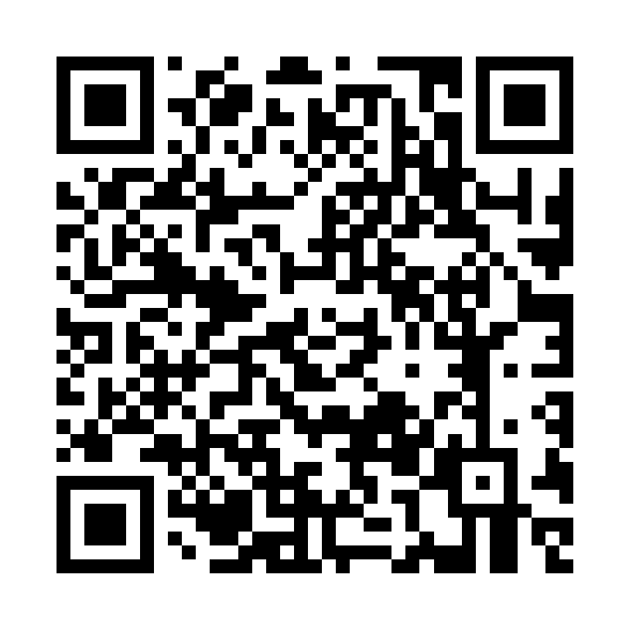
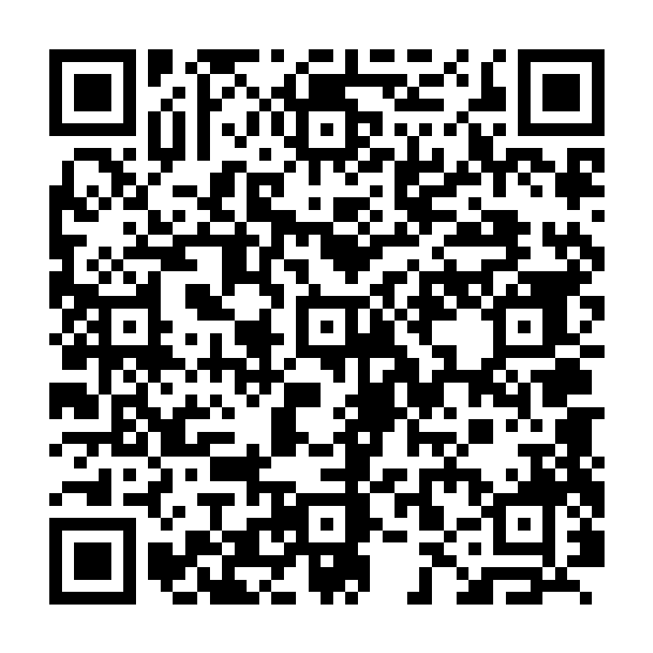
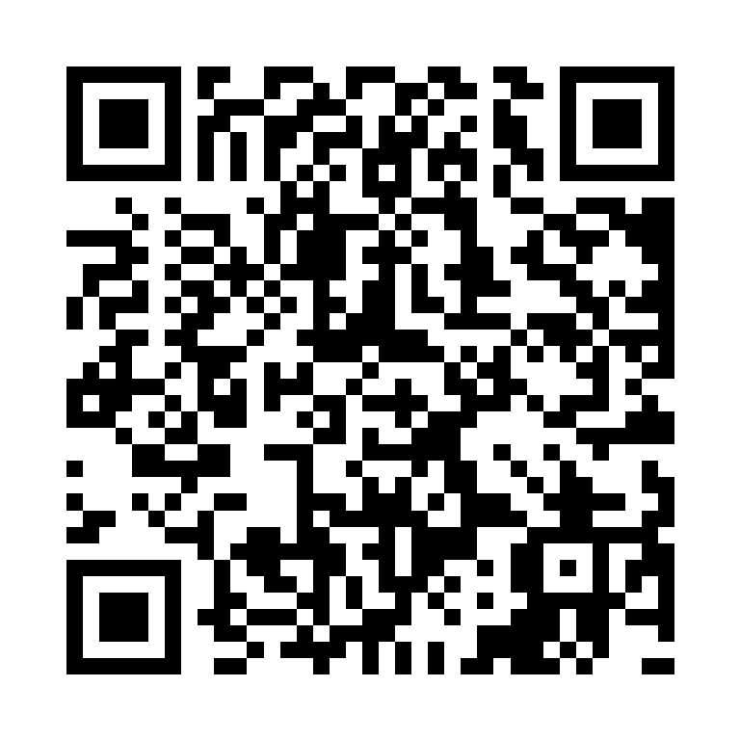

DEVFEST KC / 2026
Explore the research. Stay connected.
DevFest KC 2026 | Predictive Modeling of Cloud System Failures
Portfolio
Google Scholar
LinkedIn
akhiljoshi-portfolio.pages.dev
Research & publications
Connect professionally
Thank you to GDG Kansas City and everyone who joined the session.

